Slide 1







수학적으로
접근하는 딥러닝
21010469 김민경

Slide 2

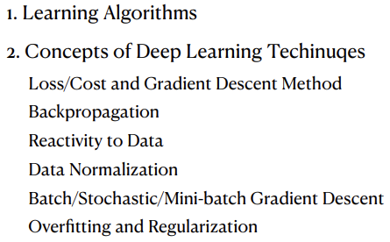
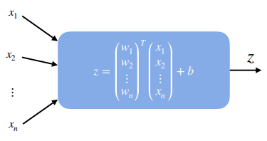
Why We Learn Linear Regression?

Slide 3
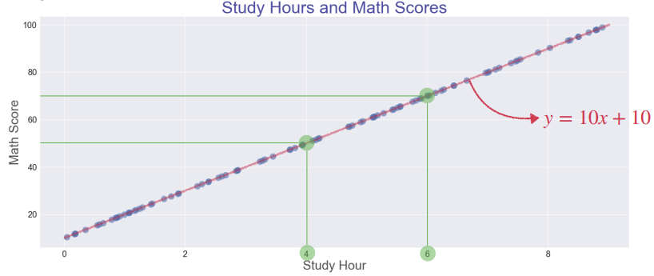
What’s Regression?

Slide 4
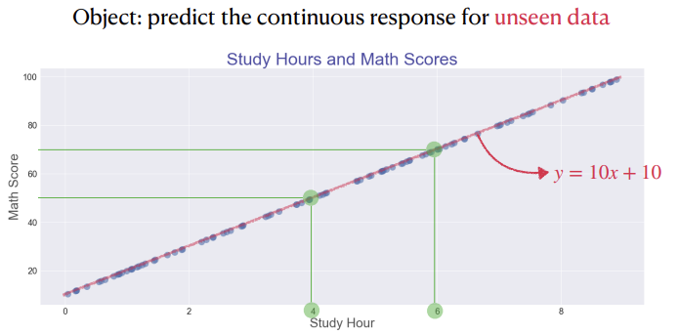
What’s Regression?

Slide 5
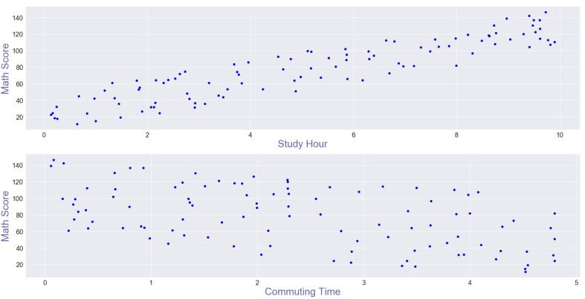
What’s Regression?

Slide 6
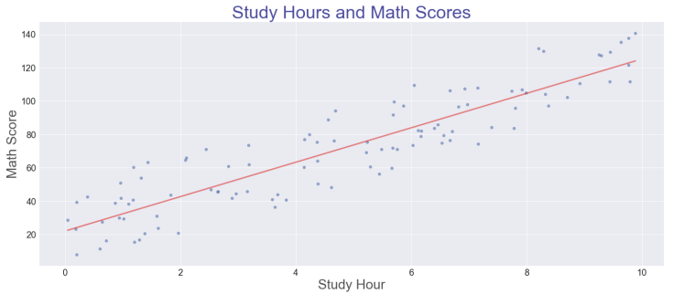
What’s Regression?

Slide 7
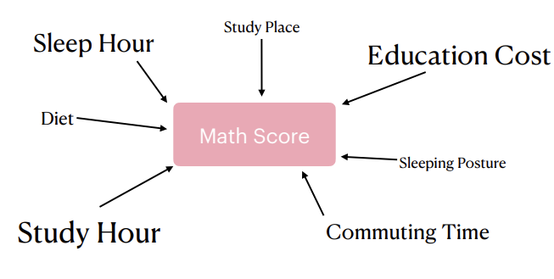
What’s Regression?

Slide 8
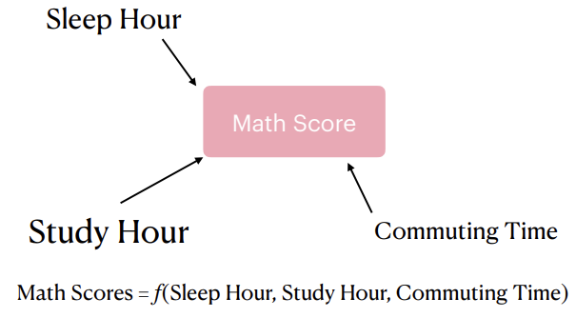
What’s Regression?

Slide 9
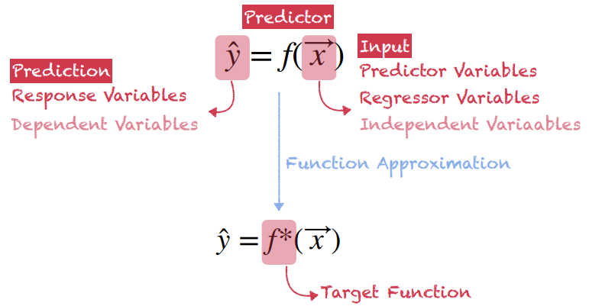
What’s Regression?

Slide 10
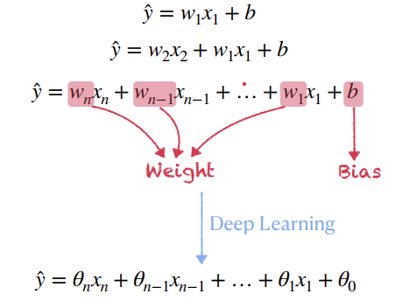
What’s Linear?

Slide 11
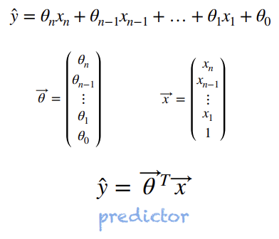
What’s Linear?

Slide 12
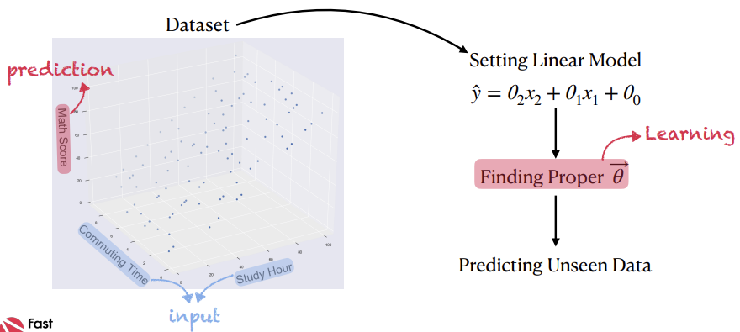

What’s Linear?

Slide 13
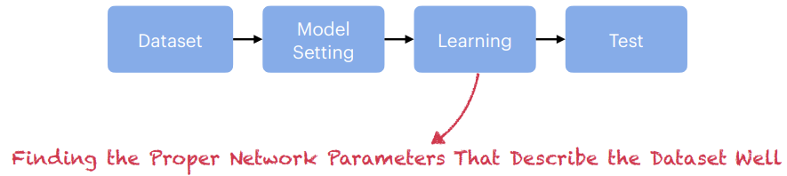
Learning in Deep Learning

Slide 14
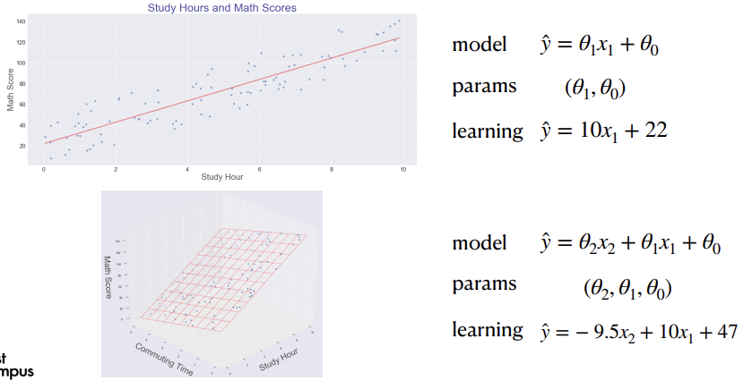

Learning in Deep Learning

Slide 15
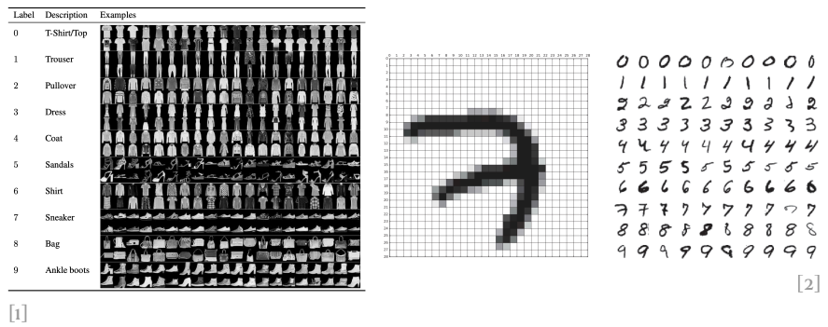
Linear Regression in Deep Learning

Slide 16
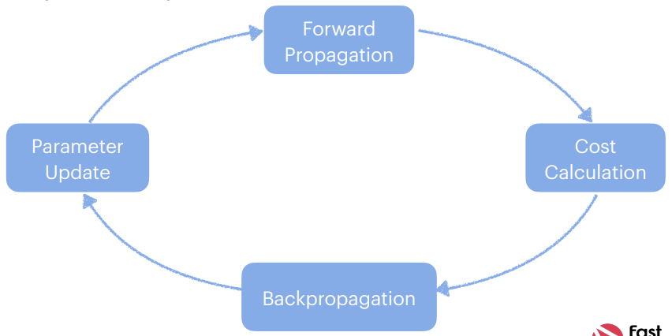

Linear Regression in Deep Learning

Slide 17
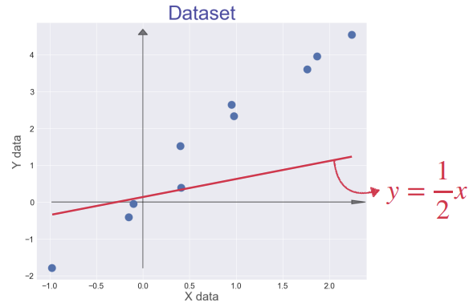
Loss and Cost Function

Slide 18
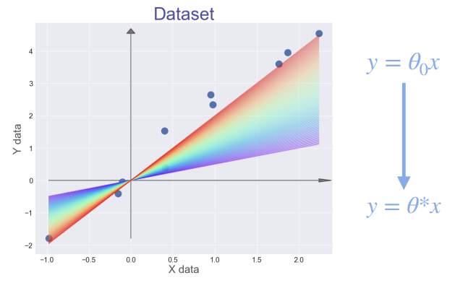
Loss and Cost Function

Slide 19
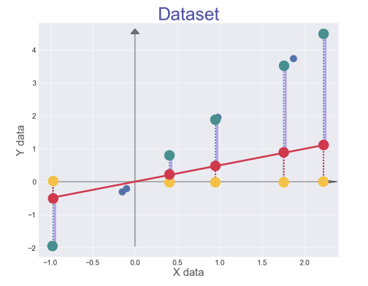
Loss and Cost Function

Slide 20
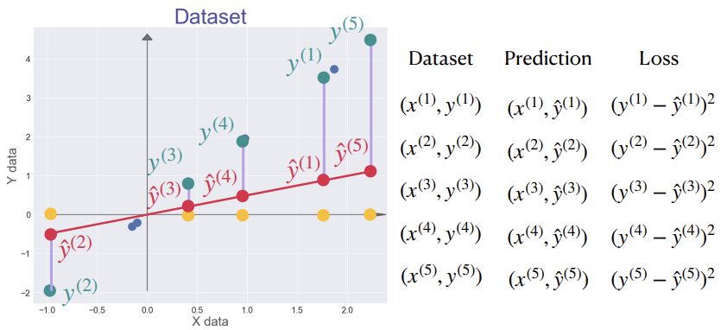
Loss and Cost Function

Slide 21
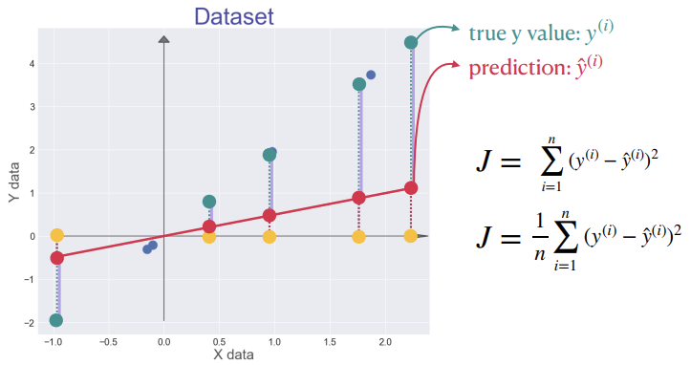
Loss and Cost Function

Slide 22
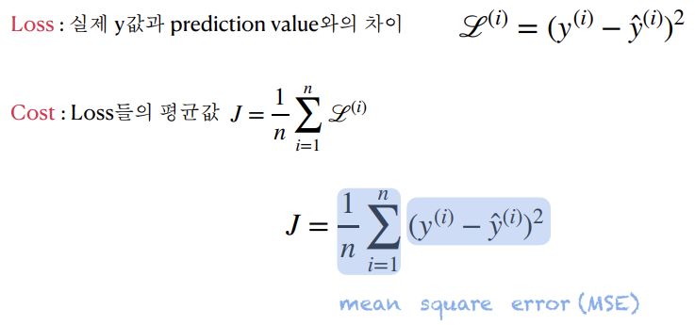
Loss and Cost Function

Slide 23
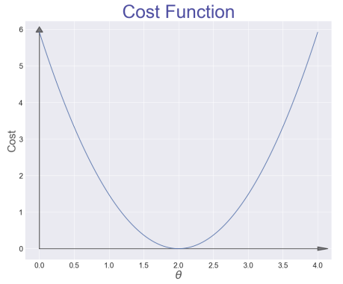
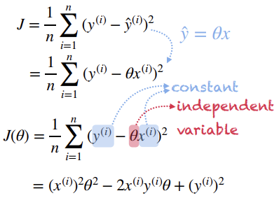
Loss and Cost Function

Slide 24
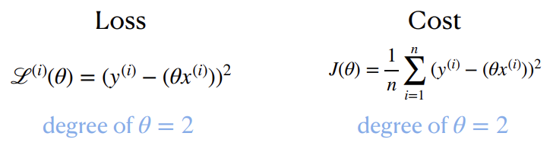
Loss and Cost Function

Slide 25
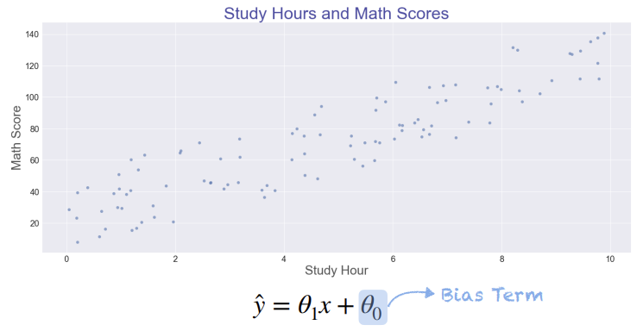
Loss and Cost Function

Slide 26
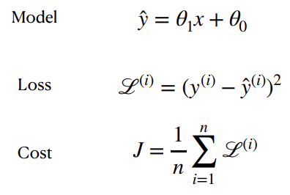
Loss and Cost Function

Slide 27
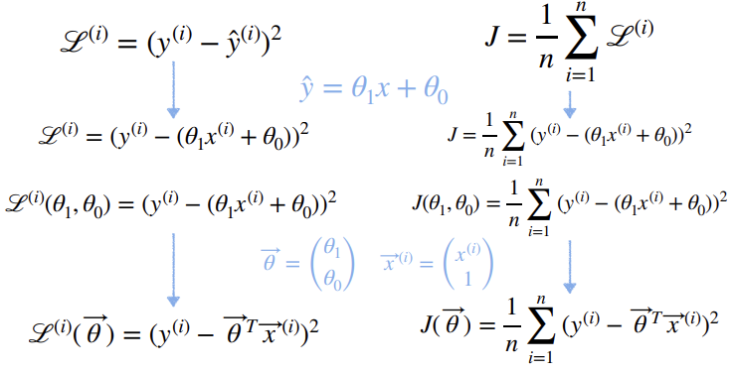
Loss and Cost Function

Slide 28
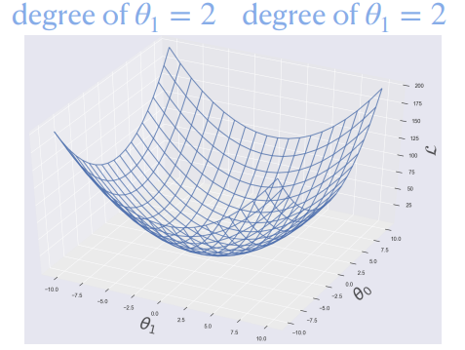
Loss and Cost Function

Slide 29
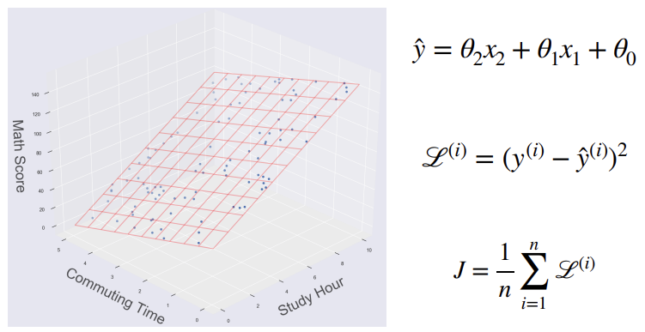
Loss and Cost Function

Slide 30
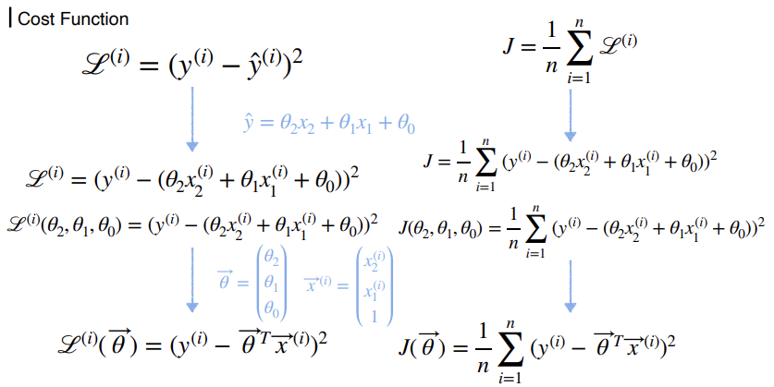
Loss and Cost Function

Slide 31
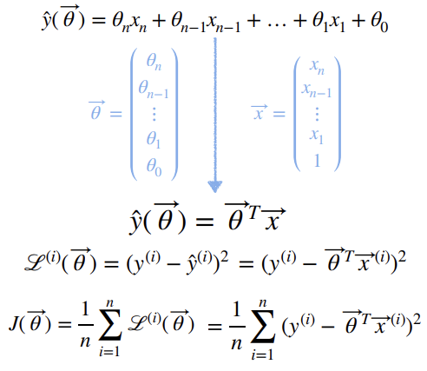
Loss and Cost Function

Slide 32
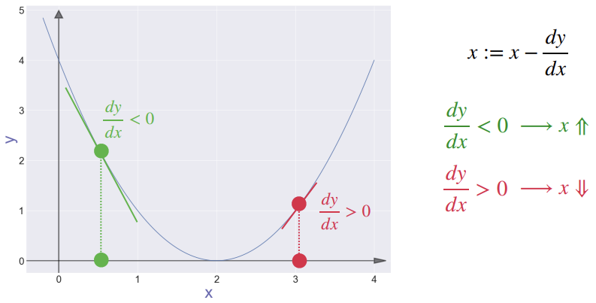
Gradient Descent Method

Slide 33
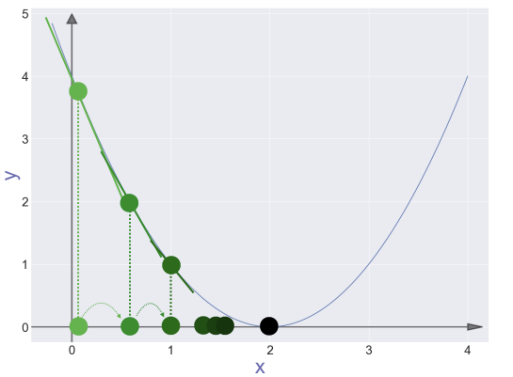
Gradient Descent Method

Slide 34
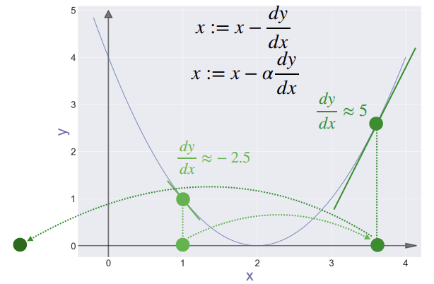
Gradient Descent Method

Slide 35
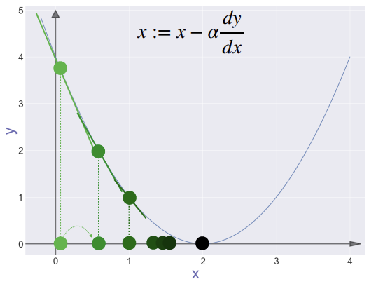
Gradient Descent Method

Slide 36
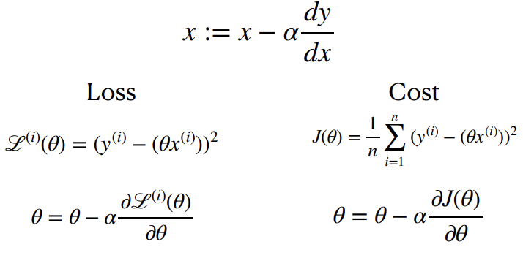
Gradient Descent Method

Slide 37
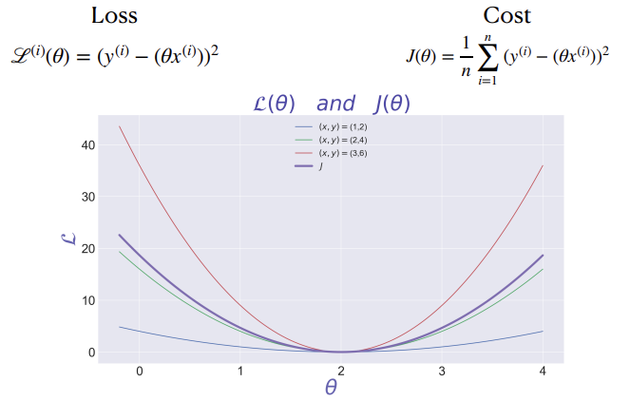
Gradient Descent Method

Slide 38
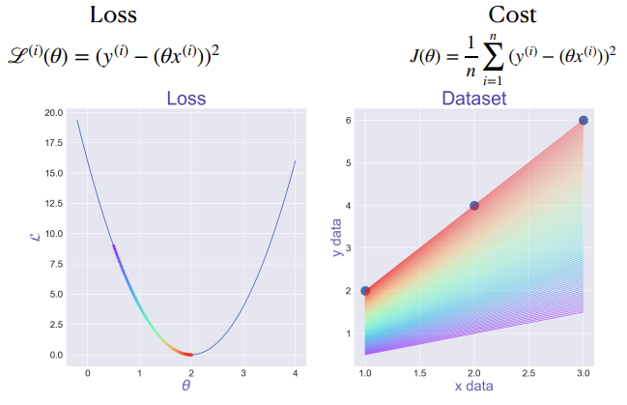
Gradient Descent Method

Slide 39
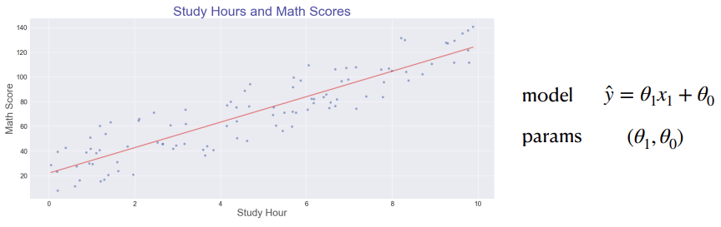
Gradient Descent Method

Slide 40
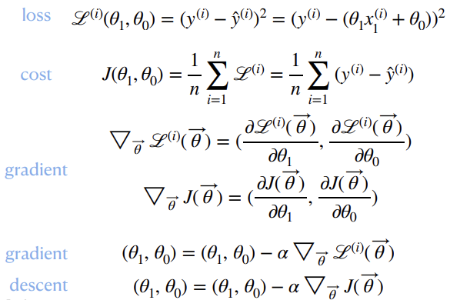
Gradient Descent Method

Slide 41
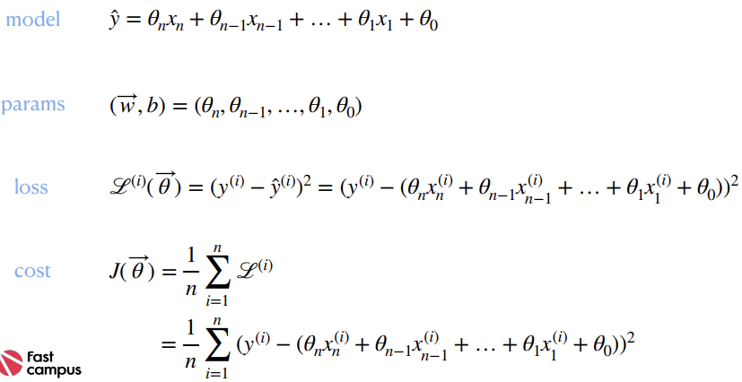

Gradient Descent Method

Slide 42
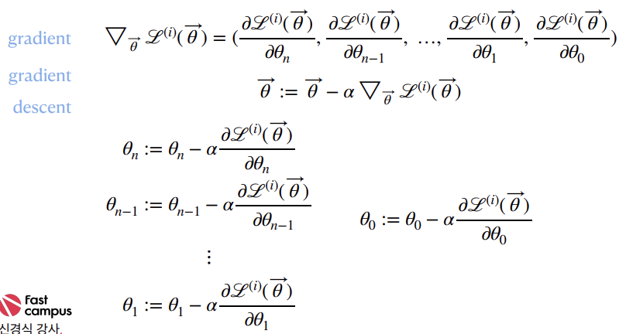

Gradient Descent Method

Slide 43
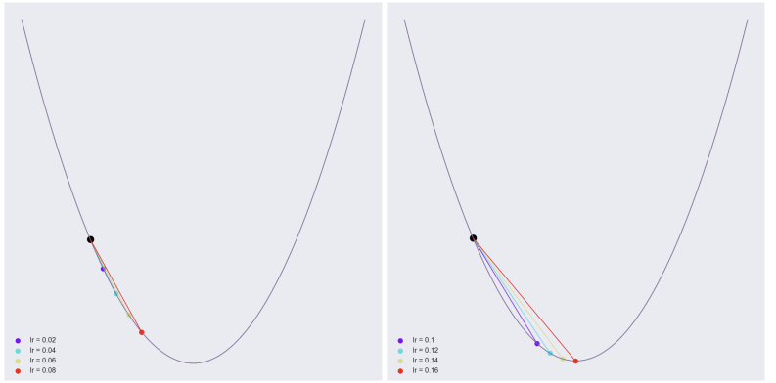
Learning Rate

Slide 44
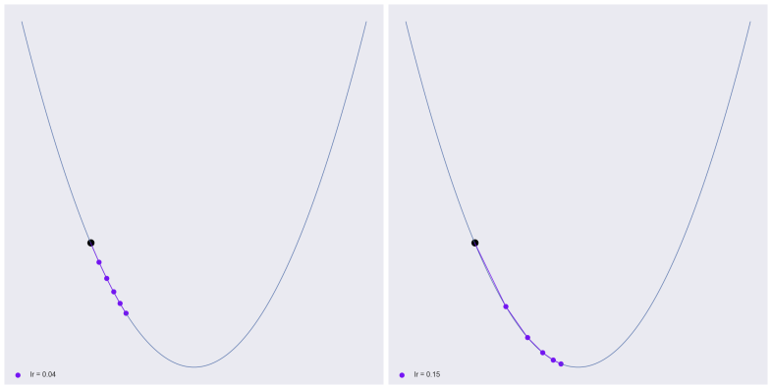
Learning Rate

Slide 45
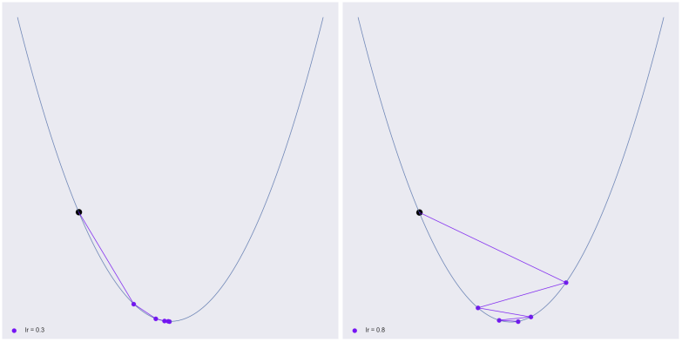
Learning Rate

Slide 46
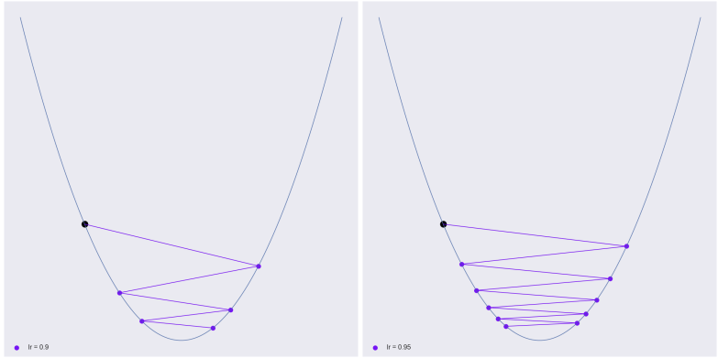
Learning Rate

Slide 47
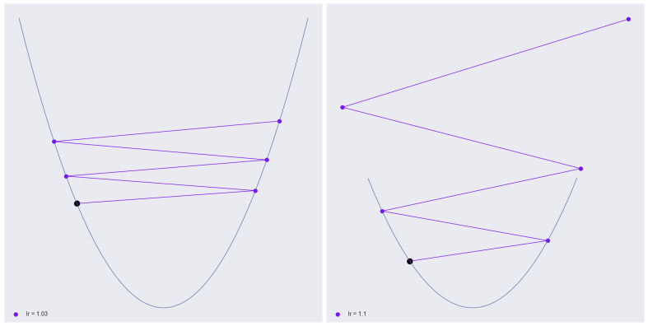
Learning Rate

Slide 48
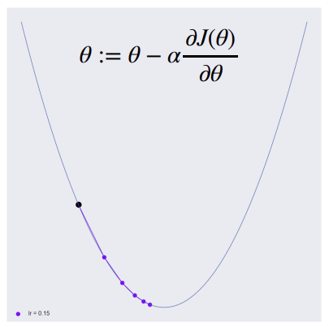
Parameter Update

Slide 49
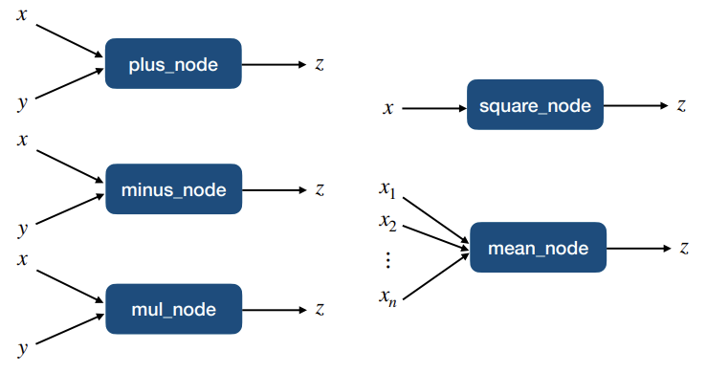
Basic Building Nodes

Slide 50

Basic Building Nodes

Slide 51

Basic Building Nodes

Slide 52

Basic Building Nodes

Slide 53


Basic Building Nodes

Slide 54

Basic Building Nodes

Slide 55

Basic Building Nodes

Slide 56

Basic Building Nodes

Slide 57

Basic Building Nodes

Slide 58

Basic Building Nodes

Slide 59

Basic Building Nodes

Slide 60

Basic Building Nodes

Slide 61

For a Single Sample

Slide 62

For a Single Sample

Slide 63

For a Single Sample

Slide 64

For a Single Sample

Slide 65


For a Single Sample

Slide 66


For a Single Sample

Slide 67



THANKS FOR WATCHING

